Slide 1
AN AI - Powered Exam Preparation APP For Aspirants.
Presented By I RAHUL(192210528)
CSE Department
SIMATS Engineering

Slide 2
PROJECT OVERVIEW
THE PRODUCT:
The AI-Based Competitive Exam Preparation App is an intelligent, scalable, and cost-effective digital learning solution that helps candidates with instant AI-driven doubt resolution, adaptive mock testing, and organized Previous Year Question (PYQ) practice. To ensure seamless and reliable operation for a broad user base, the product incorporates individualized performance statistics, secure student and administrator access, and a cloud-based architecture. The software improves exam readiness through self-paced and data-driven learning while remaining accessible, efficient, and cost-effective.
PROJECT TIMELINE: 11 WEEKS

Slide 3
PROBLEM STATEMENT
In today's competitive exam market, applicants confront a number of problems, including expensive coaching costs, a lack of individualized learning help, and difficulty tracking exam readiness. Most present platforms rely largely on live classes or generic material distribution, limiting accessibility and failing to properly address individual concerns. Furthermore, students frequently struggle to recognize their weak points and practice effectively, resulting in poor preparation outcomes. The suggested AI-powered app intends to address these issues by offering affordable, self-paced, and tailored exam preparation that includes fast doubt resolution, adaptive mock testing, and performance statistics.

Slide 4
PROJECT OVERVIEW
Problem:
Many existing platforms rely on expensive live classes and premium subscriptions, making quality preparation inaccessible for a large segment of students.
Generic apps fail to provide instant, tailored doubt resolution and adaptive practice, limiting students’ ability to address individual weaknesses.
Students often struggle to monitor their progress or identify weak areas effectively, resulting in less focused preparation and lower exam performance.
Goal:
To provide affordable, AI-powered and personalized competitive exam preparation accessible to all aspirants.
To improve exam success rates through instant doubt resolution, adaptive mock testing, and data-driven performance analytics.

Slide 5
PROJECT OVERVIEW
My role:
Designed and conceptualized the AI-based competitive exam preparation platform, defining its architecture, features, and system workflow.
Led the development planning, including AI logic design, mock test framework, database structure, and overall project documentation.
My responsibilities:
Responsible for system design, AI model logic planning, database structuring, and defining the overall application architecture.
Responsible for coordinating development tasks, ensuring security standards, maintaining documentation, and validating performance and functionality of the platform.

Slide 6
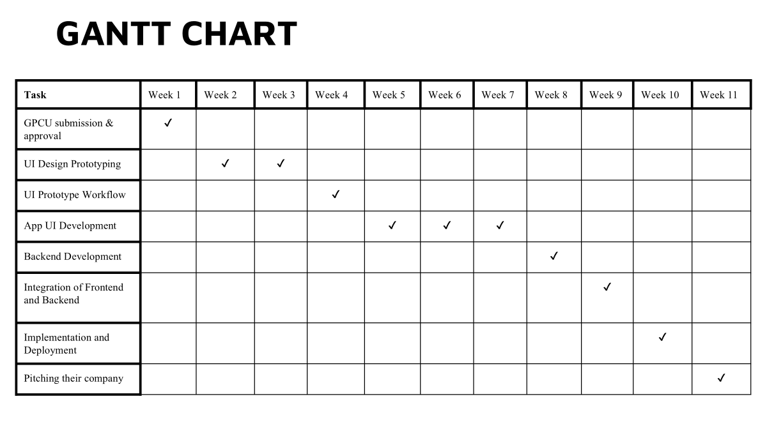

Slide 7
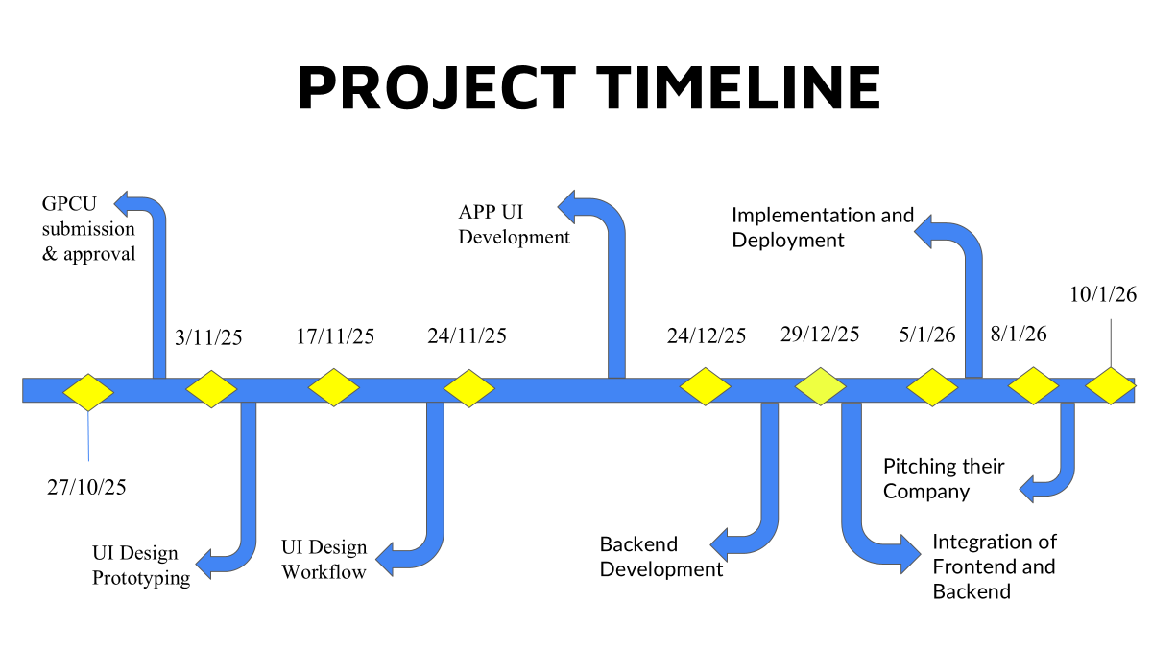

Slide 8
UNDERSTANDING THE USERS
Aspirants(Preparing Govt. Exams)
Students(Preparing for aptitude)

Slide 9
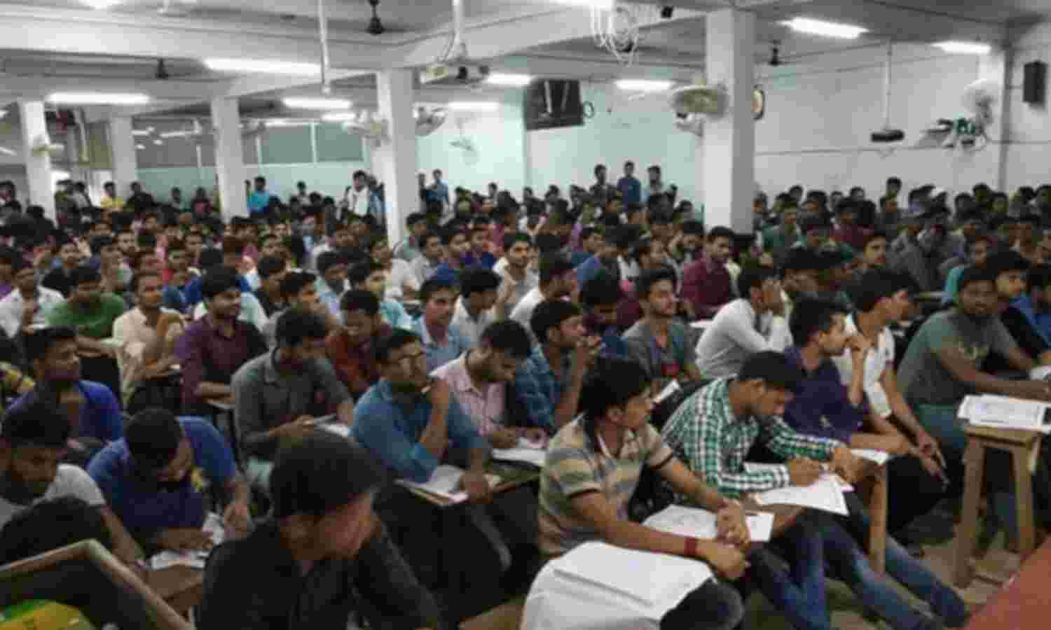
Aspirants
Goal: To provide affordable, AI-powered and personalized competitive exam preparation for aspirants.
Frustration: Students struggle with high-cost coaching, lack of instant doubt support, and poor progress tracking.
Problem Statement: Existing platforms fail to deliver affordable, personalized, and real-time exam preparation support tailored to individual performance needs.

Slide 10
COMPETITIVE ANALYSIS

Slide 11
User Research: Summary
User research was conducted through surveys and informal interviews with competitive exam aspirants from diverse academic and economic backgrounds. The findings revealed that students face challenges such as high coaching costs, delayed doubt resolution, lack of personalized practice, and difficulty tracking progress effectively. Many preferred self-paced digital solutions over live classes. The research highlighted strong demand for an affordable, AI-powered platform offering instant doubt solving, adaptive mock tests, and structured performance analytics tailored to individual exam preparation needs.

Slide 12
BUSINESS POTENTIAL
Large Target Market: India has millions of competitive exam aspirants annually, creating strong and recurring demand for affordable digital preparation solutions.
Scalable Subscription Model: Low-cost monthly or yearly subscription plans can generate consistent recurring revenue with high user retention.
Multi-Exam Expansion Opportunities: The platform can expand to cover various government, entrance, and certification exams, increasing revenue streams.
Partnership & Institutional Tie-ups: Potential collaborations with colleges, coaching centers, and educational institutions can open B2B revenue channels and bulk subscriptions.

Slide 13
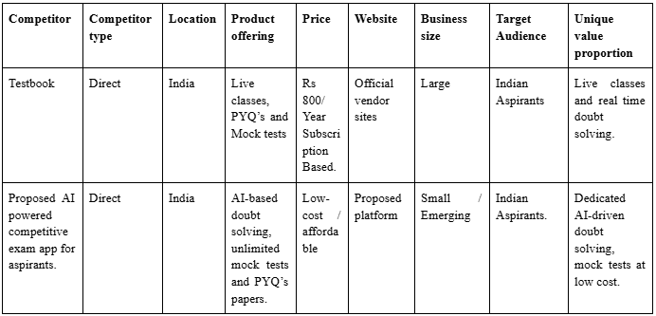
COMPETITIVE ANALYSIS

Slide 14
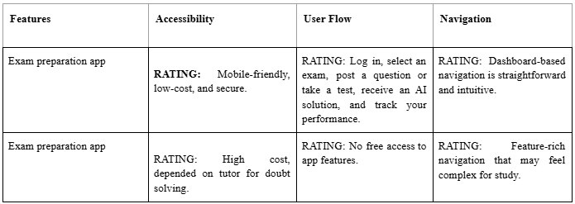
COMPETITIVE ANALYSIS

Slide 15
User Research: Pain Points
Complex Planning & Architecture Understanding:
Demonstrates the ability to design a multi-layered system architecture integrating AI engines, adaptive testing modules, databases, and cloud infrastructure in a cohesive manner.
Reflects strong understanding of scalable planning, secure data flow, performance optimization, and structured module interaction within a real-world EdTech application.
Lack of mobile optimization:
Poor mobile optimization can lead to slow loading times, distorted layouts, and reduced usability on smartphones, affecting student engagement.
Inadequate responsive design may cause navigation issues and accessibility challenges, limiting the app’s effectiveness for mobile-first users.

Slide 16
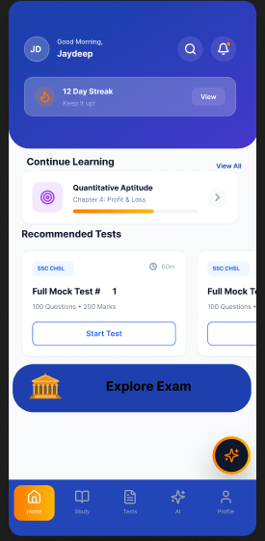
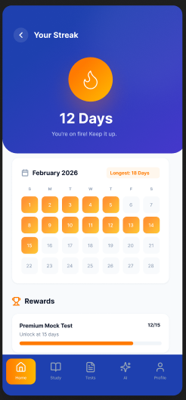
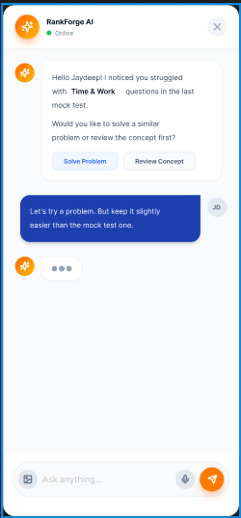
MOCKUPS LOW FIDELITY-(CONVERGENCE)

Slide 17
USABILITY STUDIES
Round 01 – LLD Generation Confusion
●The initial idea-to-LLD screen showed too many options at once (Q&A input, chatbot edit, export, save, history, tech stack), which confused first-time users.
●Participants struggled to identify the main action—starting the guided Q&A—because many buttons appeared with equal importance.
●Recommendation: Simplify the entry screen by highlighting the main “Start Q&A” action and grouping other features (history, export, settings, saved projects) under menus for a cleaner, focused experience.
Round 02 – Feature Accessibility Improvement
●After simplifying the interface, users wanted faster access to saved projects, previous LLD versions, and investor-shared project packages.
●Users also requested more control over how architecture is shown, including diagram view, text explanation, tech stack view, and investor-ready summaries.
●Recommendation: Add customizable LLD views and quick-access icons for Saved Projects, Versions, Tech Stack, and Investor Requests to improve navigation speed and support better idea sharing.

Slide 18
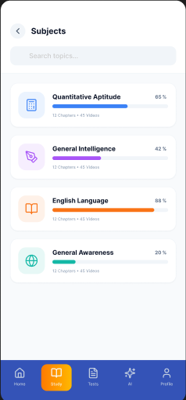
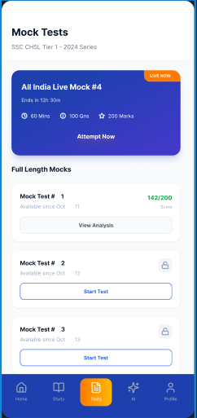
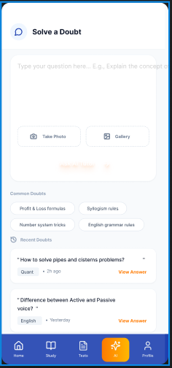
PRODUCT HI FIDELITY

Slide 19
PRODUCT DESIGN MOCKUPS
Impact of the Project:
Enhances accessibility to affordable, AI-powered competitive exam preparation, empowering students from diverse economic and geographic backgrounds.
Improves exam readiness and performance through personalized doubt resolution, adaptive testing, and data-driven learning insights.
What We Learned from the Project:
Gained practical understanding of designing a scalable AI-based system architecture, including database structuring, adaptive logic building, and secure cloud integration.
Learned the importance of user-centric design, performance optimization, and data-driven decision-making in building an effective and commercially viable EdTech product.

Slide 20
PRODUCT DESIGN PATENT
Unique Features:
Custom AI Doubt Engine: Proprietary AI system tailored specifically to competitive exam patterns for instant, exam-focused explanations.
Adaptive Mock Intelligence: Dynamically adjusts question difficulty and topic focus based on real-time performance analytics.
Integrated PYQ Trend Analysis: Organizes and analyzes previous year questions to identify frequently asked topics and predict preparation priorities.
Link:https://docs.google.com/document/d/1ObbwCYQqxkhPMQAFDY4w3i5Xkahl4huGMzWZ-sa7DTs/edit?usp=sharing

Slide 21
Development Stack
FRONTEND
●Platform: Android (Java)
●UI Design: Figma
●Framework: Android Studio with XML layouts + RecyclerView, Adapters, Activities/Fragments
●Purpose: User onboarding, idea input, domain selection, and LLD result display
BACKEND
●Language: Node.js (JavaScript)
●Framework: Express.js (REST API)
●Server: Apache (XAMPP) during development
●Functionality:
○Handles user authentication
○Processes idea submissions
○Connects with AI services
○Manages project requests and responses
DATABASE
●Type: MySQL
●Name: Idea2LLD
●Backend + Database:
○Node.js + MySQL for CRUD operations
○Stores users, projects, requests, and categories
●Frontend + Backend:
○API (HTTP requests) via Retrofit / Volley in Android
○Node.js APIs → MySQL queries
○JSON-based responses

Slide 22
Thank you
name@example.com

